Slide 1
Information Gathering: Interactive Methods
4
Systems Analysis and Design, 8e
Kendall & Kendall

Slide 2
Objectives
Recognize the value of interactive methods for information gathering.
Construct interview questions to elicit human information requirements.
Structure interviews in a way that is meaningful to users.
Understand the concept of JAD and when to use it.
Write effective questions to survey users about their work.
Design and administer effective questionnaires.
Kendall & Kendall Copyright © 2011 Pearson Education, Inc. Publishing as Prentice Hall
4-<number>

Slide 3
Interactive Methods to Elicit Human Information Requirements
Interviewing
Joint Application Design (JAD)
Questionnaires
Kendall & Kendall Copyright © 2011 Pearson Education, Inc. Publishing as Prentice Hall
4-<number>
Notes:
The commonality of these methods is talking with and listening to people in the organization in order to understand their interactions with technology through a series of carefully composed questions.

Slide 4
Major Topics
Interviewing
  Interview preparation
  Question types
  Arranging questions
  The interview report
Joint Application Design (JAD)
  Involvement
  Location
Questionnaires
  Writing questions
  Using scales
  Design
  Administering
Kendall & Kendall Copyright © 2011 Pearson Education, Inc. Publishing as Prentice Hall
4-<number>

Slide 5
Interviewing
Interviewing is an important method for collecting data on human and system information requirements.
Interviews reveal information about:
    Interviewee opinions
    Interviewee feelings
    Goals
    Key HCI concerns
Kendall & Kendall Copyright © 2011 Pearson Education, Inc. Publishing as Prentice Hall
4-<number>
Notes:
Opinions – may be more revealing and more important then facts. By seeking opinion rather then fact you can discover key problems.
Feelings – You can understand the organization’s culture more fully by listening to the feelings of the respondent.
Goals – project the organization’s future. You may not be able to determine goals through any other method.
HCI – the ergonomic aspects, the system usability, how pleasing and enjoyable the system is, and how useful it is in supporting individual tasks.

Slide 6
Interview Preparation
Reading background material
Establishing interview objectives
Deciding whom to interview
Preparing the interviewee
Deciding on question types and structure
Kendall & Kendall Copyright © 2011 Pearson Education, Inc. Publishing as Prentice Hall
4-<number>
Notes:
Reading background material – read and understand as much background information about the interviewees and their organization as possible.
Corporate Web site
Current annual report
Corporate news letter
Any publication sent out to explain the organization to the public
Standard and Poor’s
Trying to build a common vocabulary to phrase interview questions and to maximize the interview time.
Establishing interview objectives – four to six key areas concerning HCI, information processing and decision-making behavior
Deciding whom to interview – Strive for balance so that as many users’ needs are addressed as possible.
Preparing the interviewee – Call ahead; keep to 45 minutes to an hour at the most.
Deciding on question types and structure – write questions to cover the key areas of decision making that you discovered when you ascertained interview objectives.

Slide 7
Question Types
Open-ended
Closed
Kendall & Kendall Copyright © 2011 Pearson Education, Inc. Publishing as Prentice Hall
4-<number>
Notes:
Each question type can accomplish something a little different from the other, and each has benefits and drawbacks.

Slide 8
Open-Ended Questions
Open-ended interview questions allow interviewees to respond how they wish, and to what length they wish.
Open-ended interview questions are appropriate when the analyst is interested in breadth and depth of reply.
Kendall & Kendall Copyright © 2011 Pearson Education, Inc. Publishing as Prentice Hall
4-<number>
Notes:
“Open” actually describes the interviewee’s options for responding. They are open.

Slide 9
Advantages of Open-Ended Questions
Puts the interviewee at ease
Allows the interviewer to pick up on the interviewee’s vocabulary
Provides richness of detail
Reveals avenues of further questioning that may have gone untapped
Kendall & Kendall Copyright © 2011 Pearson Education, Inc. Publishing as Prentice Hall
4-<number>

Slide 10
Advantages of Open-Ended Questions (Continued)
Provides more interest for the interviewee
Allows more spontaneity
Makes phrasing easier for the interviewer
Useful if the interviewer is unprepared
Kendall & Kendall Copyright © 2011 Pearson Education, Inc. Publishing as Prentice Hall
4-<number>

Slide 11
Disadvantages of Open-Ended Questions
May result in too much irrelevant detail
Possibly losing control of the interview
May take too much time for the amount of useful information gained
Potentially seeming that the interviewer is unprepared
Possibly giving the impression that the interviewer is on a “fishing expedition”
Kendall & Kendall Copyright © 2011 Pearson Education, Inc. Publishing as Prentice Hall
4-<number>
Notes:
The analyst needs to carefully consider the implications of using open-ended questions for interviewing.

Slide 12
Closed Interview Questions
Closed interview questions limit the number of possible responses.
Closed interview questions are appropriate for generating precise, reliable data that is easy to analyze.
The methodology is efficient, and it requires little skill for interviewers to administer.
Kendall & Kendall Copyright © 2011 Pearson Education, Inc. Publishing as Prentice Hall
4-<number>
Notes:
The alternative to open-ended questions.

Slide 13
Benefits of Closed Interview Questions
Saving interview time
Easily comparing interviews
Getting to the point
Keeping control of the interview
Covering a large area quickly
Getting to relevant data
Kendall & Kendall Copyright © 2011 Pearson Education, Inc. Publishing as Prentice Hall
4-<number>

Slide 14
Disadvantages of Closed Interview Questions
Boring for the interviewee
Failure to obtain rich detailing
Missing main ideas
Failing to build rapport between interviewer and interviewee
Kendall & Kendall Copyright © 2011 Pearson Education, Inc. Publishing as Prentice Hall
4-<number>
Notes:
As the interviewer you must think carefully about the question types you will use.

Slide 15
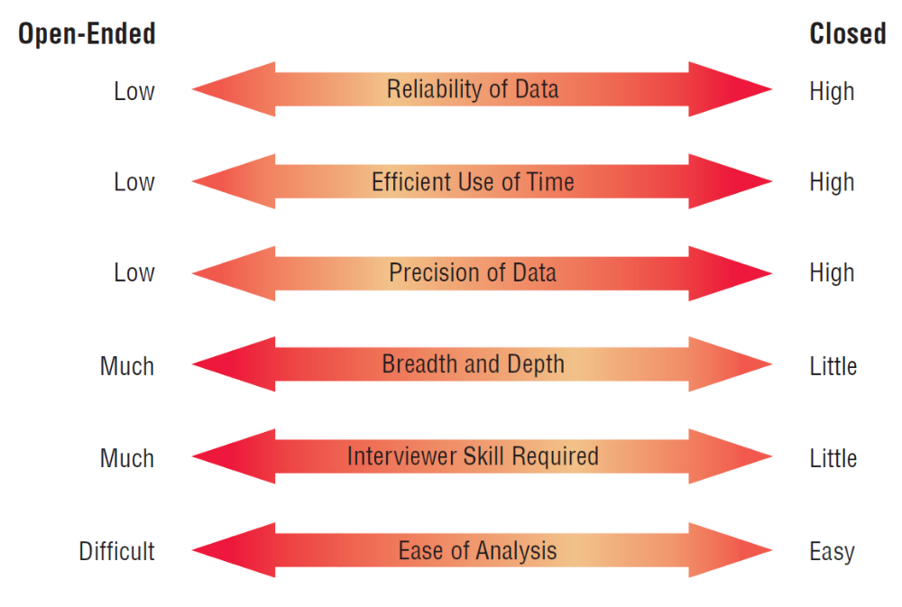
Attributes of Open-Ended and Closed Questions (Figure 4.5)
Kendall & Kendall Copyright © 2011 Pearson Education, Inc. Publishing as Prentice Hall
4-<number>
Notes:
Choosing one question type over the other involves a trade-off; although an open-ended question affords breath and depth of reply, responses to open-ended questions are difficult to analyze.

Slide 16
Bipolar Questions
Bipolar questions are those that may be answered with a “yes” or “no” or “agree” or “disagree.”
Bipolar questions should be used sparingly.
A special kind of closed question
Kendall & Kendall Copyright © 2011 Pearson Education, Inc. Publishing as Prentice Hall
4-<number>
Notes:
This type of closed question limits the interviewee even further by allowing a choice on either “pole”, such as yes or no, true or false, agree or disagree.

Slide 17
Probes
Probing questions elicit more detail about previous questions.
The purpose of probing questions is:
  To get more meaning
  To clarify
  To draw out and expand on the interviewee’s point
May be either open-ended or closed
Kendall & Kendall Copyright © 2011 Pearson Education, Inc. Publishing as Prentice Hall
4-<number>
Notes:
Used as a follow-up question.
The strongest probe is simply - Why?
It is essential to probe so that we don’t accept superficial answers.

Slide 18
Arranging Questions
Pyramid
  Starting with closed questions and working toward open-ended questions
Funnel
  Starting with open-ended questions and working toward closed questions
Diamond
  Starting with closed, moving toward open-ended, and ending with closed questions
Kendall & Kendall Copyright © 2011 Pearson Education, Inc. Publishing as Prentice Hall
4-<number>
Notes:
There are two ways of organizing interviews – Pyramid and Funnel, the diamond approach combines both.

Slide 19
Pyramid Structure
Begins with very detailed, often closed questions
Expands by allowing open-ended questions and more generalized responses
Is useful if interviewees need to be warmed up to the topic or seem reluctant to address the topic
Kendall & Kendall Copyright © 2011 Pearson Education, Inc. Publishing as Prentice Hall
4-<number>
Notes:
Inductive organization of interview questions.
Also useful if you want an ending determination about the topic.

Slide 20
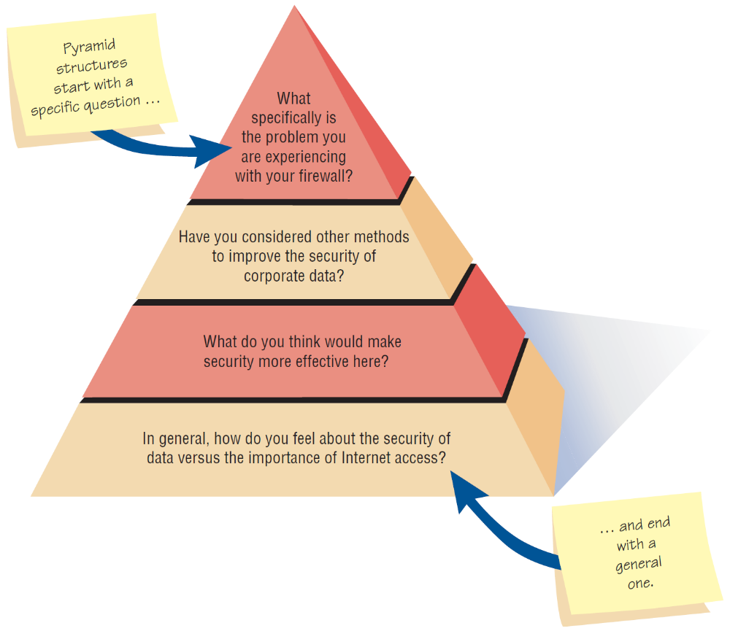
Pyramid Structure for Interviewing Goes from Specific to General Questions (Figure 4.7 )
Kendall & Kendall Copyright © 2011 Pearson Education, Inc. Publishing as Prentice Hall
4-<number>

Slide 21
Funnel Structure
Begins with generalized, open-ended questions
Concludes by narrowing the possible responses using closed questions
Provides an easy, nonthreatening way to begin an interview
Is useful when the interviewee feels emotionally about the topic
Kendall & Kendall Copyright © 2011 Pearson Education, Inc. Publishing as Prentice Hall
4-<number>
Notes:
Deductive organization of interview questions.

Slide 22
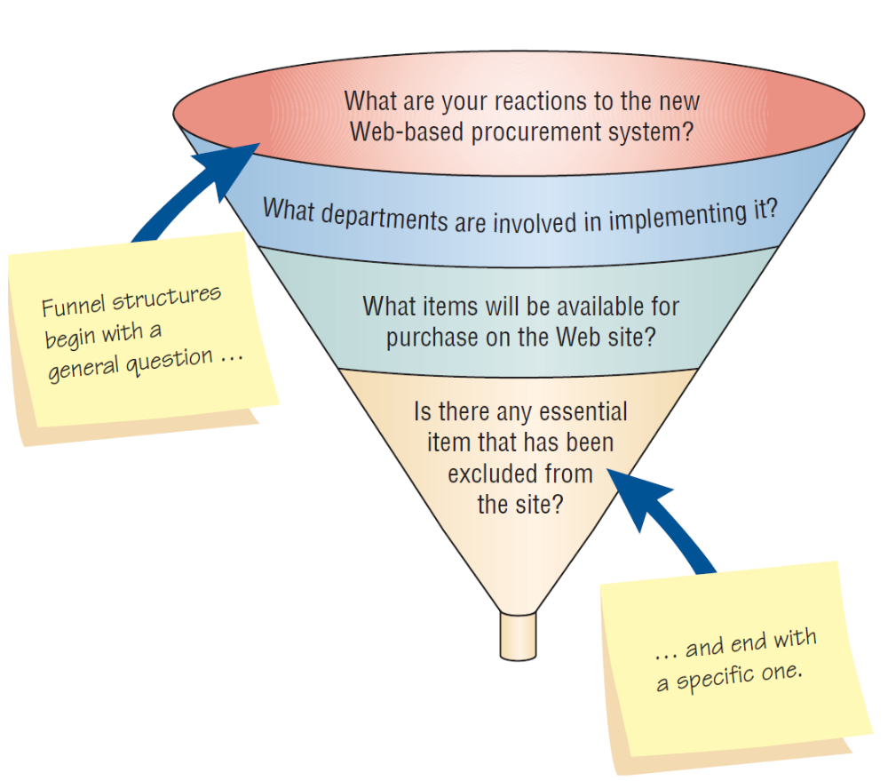
Funnel Structure for Interviewing Begins with Broad Questions then Funnels to Specific Questions (Figure 4.8)
Kendall & Kendall Copyright © 2011 Pearson Education, Inc. Publishing as Prentice Hall
4-<number>

Slide 23
Diamond Structure
A diamond-shaped structure begins in a very specific way.
Then more general issues are examined
Concludes with specific questions
Combines the strength of both the pyramid and funnel structures
Takes longer than the other structures
Kendall & Kendall Copyright © 2011 Pearson Education, Inc. Publishing as Prentice Hall
4-<number>
Notes:
The diamond structure combines the strengths of the pyramid and funnel approach but has the disadvantage of taking longer.

Slide 24
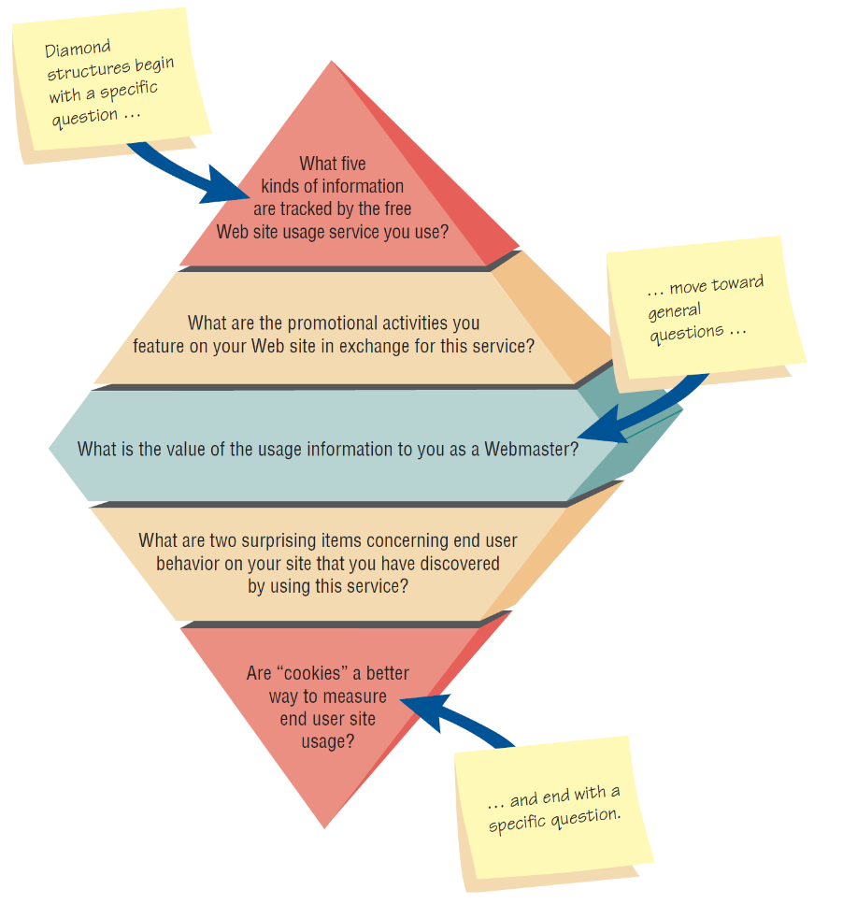
Diamond-Shaped Structure for Interviewing Combines the Pyramid and Funnel Structures (Figure 4.9)
Kendall & Kendall Copyright © 2011 Pearson Education, Inc. Publishing as Prentice Hall
4-<number>

Slide 25
Closing the Interview
Always ask “Is there anything else that you would like to add?”
Summarize and provide feedback on your impressions.
Ask whom you should talk with next.
Set up any future appointments.
Thank them for their time and shake hands.
Kendall & Kendall Copyright © 2011 Pearson Education, Inc. Publishing as Prentice Hall
4-<number>
Notes:
“Is there anything else that you would like to add?” – considered a formula question the response will often be “No.”
In form the interviewee about the next steps to take.
Always remember to thank the interviewee for their time.

Slide 26
Interview Report
Write as soon as possible after the interview.
Provide an initial summary, then more detail.
Review the report with the respondent.
Kendall & Kendall Copyright © 2011 Pearson Education, Inc. Publishing as Prentice Hall
4-<number>
Notes:
The longer you wait to write your report, the more suspect your data becomes.
Review the report with the respondent – this helps clarify the meaning the interviewee had in mind and lets the interviewee know that you care.

Slide 27
Joint Application Design (JAD)
Joint Application Design (JAD) can replace a series of interviews with the user community.
JAD is a technique that allows the analyst to accomplish requirements analysis and design the user interface with the users in a group setting.
Kendall & Kendall Copyright © 2011 Pearson Education, Inc. Publishing as Prentice Hall
4-<number>
Notes:
An alternative approach to interviewing users one by one.
Developed by IBM.
The motivation was to cut the time and hence the cost required by interviews. It also create more use identification with new systems as a result of the participative process.

Slide 28
Conditions that Support the Use of JAD
Users are restless and want something new.
The organizational culture supports joint problem-solving behaviors.
Analysts forecast an increase in the number of ideas using JAD.
Personnel may be absent from their jobs for the length of time required.
Kendall & Kendall Copyright © 2011 Pearson Education, Inc. Publishing as Prentice Hall
4-<number>

Slide 29
Who Is Involved
Executive sponsor
IS analyst
Users
Session leader
Observers
Scribe
Kendall & Kendall Copyright © 2011 Pearson Education, Inc. Publishing as Prentice Hall
4-<number>
Notes:
All project team members must be committed to the JAD approach and become involved.
Executive sponsor – a senior person who will introduce and conclude the JAD session.
IS Analyst – gives an expert opinion about any disproportionate costs of solutions proposed
Users – try to select users that can articulate what information they need to perform their jobs as well as what they desire in anew or improved computer system.
Session leader – someone who has excellent communication skills to facilitate appropriate interactions.
Observers – analysts or technical experts from other functional areas to offer technical explanations and advice.
Scribe – formally write down everything that is done.

Slide 30
Where to Hold JAD Meetings
Offsite
  Comfortable surroundings
  Minimize distractions
Attendance
  Schedule when participants can attend
  Agenda
  Orientation meeting
Kendall & Kendall Copyright © 2011 Pearson Education, Inc. Publishing as Prentice Hall
4-<number>
Notes:
Hold offsite to minimize the daily distractions and responsibilities of the participants’ regular work.
Do not hold the session unless everyone can attend. An agenda should be giving out before the meeting so the participants know what to expect. If possible an orientation meeting can be given.

Slide 31
Benefits of JAD
Time is saved, compared with traditional interviewing
Rapid development of systems
Improved user ownership of the system
Creative idea production is improved
Kendall & Kendall Copyright © 2011 Pearson Education, Inc. Publishing as Prentice Hall
4-<number>
Notes:
Some organizations have estimated a 15-percent time savings over traditional.
Helps users become involved early in systems projects and treats their feedback seriously.
Much like brainstorming which allows for creative idea production.

Slide 32
Drawbacks of Using JAD
JAD requires a large block of time to be available for all session participants.
If preparation or the follow-up report is incomplete, the session may not be successful.
The organizational skills and culture may not be conducive to a JAD session.
Kendall & Kendall Copyright © 2011 Pearson Education, Inc. Publishing as Prentice Hall
4-<number>
Notes:
It is not possible to do other activities concurrently or to time-shift any activities, as is typically done in one-to-one interviewing.
It is a judgmental decision if the organization is truly committed to, and prepared for , this approach.

Slide 33
Questionnaires
Questionnaires are useful in gathering information from key organization members about:
  Attitudes
  Beliefs
  Behaviors
  Characteristics
Kendall & Kendall Copyright © 2011 Pearson Education, Inc. Publishing as Prentice Hall
4-<number>
Notes:
Attributes – what people in the organization say they want.
Beliefs – what people think is actually true.
Behavior – what organizational members do.
Characteristics – properties of people or things.

Slide 34
Planning for the Use of Questionnaires
Organization members are widely dispersed.
Many members are involved with the project.
Exploratory work is needed.
Problem solving prior to interviews is necessary.
Kendall & Kendall Copyright © 2011 Pearson Education, Inc. Publishing as Prentice Hall
4-<number>

Slide 35
Question Types
Questions are designed as either:
  Open-ended
    Try to anticipate the response you will get.
    Well suited for getting opinions.
  Closed
    Use when all the options may be listed.
    When the options are mutually exclusive.
Kendall & Kendall Copyright © 2011 Pearson Education, Inc. Publishing as Prentice Hall
4-<number>
Notes:
Even when you write an open-ended question, it must be narrow enough to guide respondents to answer in a specific way.
Use open-ended questions when it is impossible to list effectively all possible responses to a question.

Slide 36
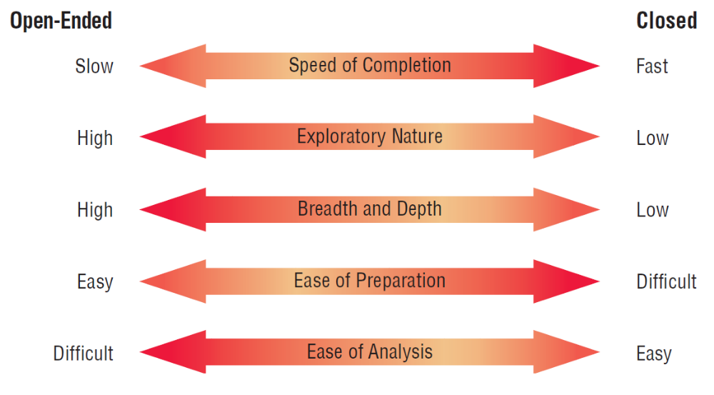
Tradeoffs between the Use of Open-Ended and Closed Questions on Questionnaires (Figure 4.12)
Kendall & Kendall Copyright © 2011 Pearson Education, Inc. Publishing as Prentice Hall
4-<number>

Slide 37
Questionnaire Language
Simple
Specific
Short
Not patronizing
Free of bias
Addressed to those who are knowledgeable
Technically accurate
Appropriate for the reading level of the respondent
Kendall & Kendall Copyright © 2011 Pearson Education, Inc. Publishing as Prentice Hall
4-<number>
Notes:
Write questionnaires in the respondents own language usage.
Simple – Use the language of the respondents whenever possible.
Specific – work at being specific rather then vague in wording.
Short – keep questions short
Not patronizing – do not talk down to participants through low-level language choices.
Free of bias – also means avoiding objectionable questions.
Addressed to those who are knowledgeable – target questions to correct respondents.

Slide 38
Measurement Scales
The two different forms of measurement scales are:
  Nominal
  Interval
Kendall & Kendall Copyright © 2011 Pearson Education, Inc. Publishing as Prentice Hall
4-<number>
Notes:
Scaling is the process of assigning numbers or other symbols to an attribute or characteristic for the purpose of measuring that attribute or characteristic.

Slide 39
Nominal Scales
Nominal scales are used to classify things.
It is the weakest form of measurement
Data may be totaled
What type of software do you use the most?
1 = Word Processor
2 = Spreadsheet
3 = Database
4 = An Email Program
Kendall & Kendall Copyright © 2011 Pearson Education, Inc. Publishing as Prentice Hall
4-<number>

Slide 40
Interval Scales
An interval scale is used when the intervals are equal.
There is no absolute zero.
Examples of interval scales include the Fahrenheit or Centigrade scale
How useful is the support given by the Technical Support Group?
NOT USEFUL EXTREMELY
AT ALL USEFUL
1 2 3 4 5
Kendall & Kendall Copyright © 2011 Pearson Education, Inc. Publishing as Prentice Hall
4-<number>
Notes:
More complete analysis can be performed on interval scales.

Slide 41
Validity And Reliability
Reliability of scales refers to consistency in response—getting the same results if the same questionnaire was administered again under the same conditions.
Validity is the degree to which the question measures what the analyst intends to measure.
Kendall & Kendall Copyright © 2011 Pearson Education, Inc. Publishing as Prentice Hall
4-<number>
Notes:
Questionnaires must be valid and reliable.

Slide 42
Problems with Scales
Leniency
Central tendency
Halo effect
Kendall & Kendall Copyright © 2011 Pearson Education, Inc. Publishing as Prentice Hall
4-<number>
Notes:
Construction of scales is a serious task which must consider the problems associated with their construction.

Slide 43
Leniency
Caused by easy raters
  Solution is to move the “average” category to the left or right of center
Kendall & Kendall Copyright © 2011 Pearson Education, Inc. Publishing as Prentice Hall
4-<number>

Slide 44
Central Tendency
Central tendency occurs when respondents rate everything as average.
  Improve by making the differences smaller at the two ends.
  Adjust the strength of the descriptors.
  Create a scale with more points.
Kendall & Kendall Copyright © 2011 Pearson Education, Inc. Publishing as Prentice Hall
4-<number>

Slide 45
Halo Effect
When the impression formed in one question carries into the next question
Solution is to place one trait and several items on each page
Kendall & Kendall Copyright © 2011 Pearson Education, Inc. Publishing as Prentice Hall
4-<number>

Slide 46
Designing the Questionnaire
Allow ample white space.
Allow ample space to write or type in responses.
Make it easy for respondents to clearly mark their answers.
Be consistent in style.
Kendall & Kendall Copyright © 2011 Pearson Education, Inc. Publishing as Prentice Hall
4-<number>
Notes:
A well designed, relevant questionnaire can help overcome some of this resistance to respond.

Slide 47
Order of Questions
Place most important questions first.
Cluster items of similar content together.
Introduce less controversial questions first.
Kendall & Kendall Copyright © 2011 Pearson Education, Inc. Publishing as Prentice Hall
4-<number>
Notes:
You want respondents to feel as unthreatened by and interested in the questions being asked as possible, without getting overwrought about a particular issue.

Slide 48
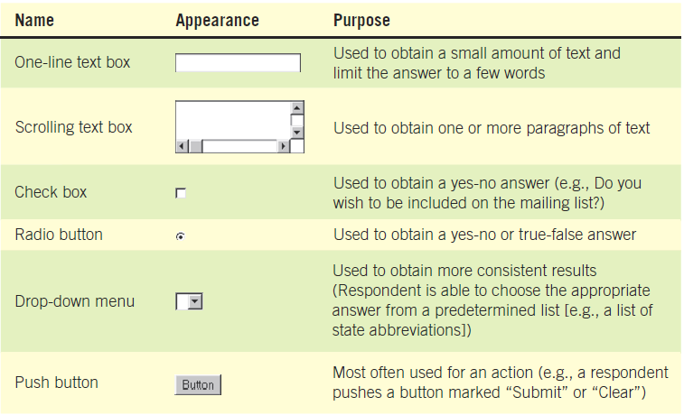
When Designing a Web Survey, Keep in Mind that There Are Different Ways to Capture Responses (Figure 4.13)
Kendall & Kendall Copyright © 2011 Pearson Education, Inc. Publishing as Prentice Hall
4-<number>
Notes:
When you design questionnaires for the Web, apply the same rules you use when designing paper questionnaires.

Slide 49
Methods of Administering the Questionnaire
Convening all concerned respondents together at one time
Personally administering the questionnaire
Allowing respondents to self-administer the questionnaire
Mailing questionnaires
Administering over the Web or via email
Kendall & Kendall Copyright © 2011 Pearson Education, Inc. Publishing as Prentice Hall
4-<number>
Notes:
The choice of administering the questionnaire may be determined by the existing business situation.
Both email and Web surveys are Self–administered; response are a little lower then other methods, but may result in less guarded answers.

Slide 50
Electronically Submitting Questionnaires
Reduced costs
Collecting and storing the results electronically
Kendall & Kendall Copyright © 2011 Pearson Education, Inc. Publishing as Prentice Hall
4-<number>
Notes:
Reminders can be sent.

Slide 51
Summary
Interviewing
  Interview preparation
  Question types
  Arranging questions
  The interview report
Joint Application Design (JAD)
  Involvement and location
Questionnaires
  Writing questions
  Using scales and overcoming problems
  Design and order
  Administering and submitting
Kendall & Kendall Copyright © 2011 Pearson Education, Inc. Publishing as Prentice Hall
4-<number>

